Slide 1
Non-Activity Visualizations
File created on: 5/23/2025 8:25:24 PM

Slide 2
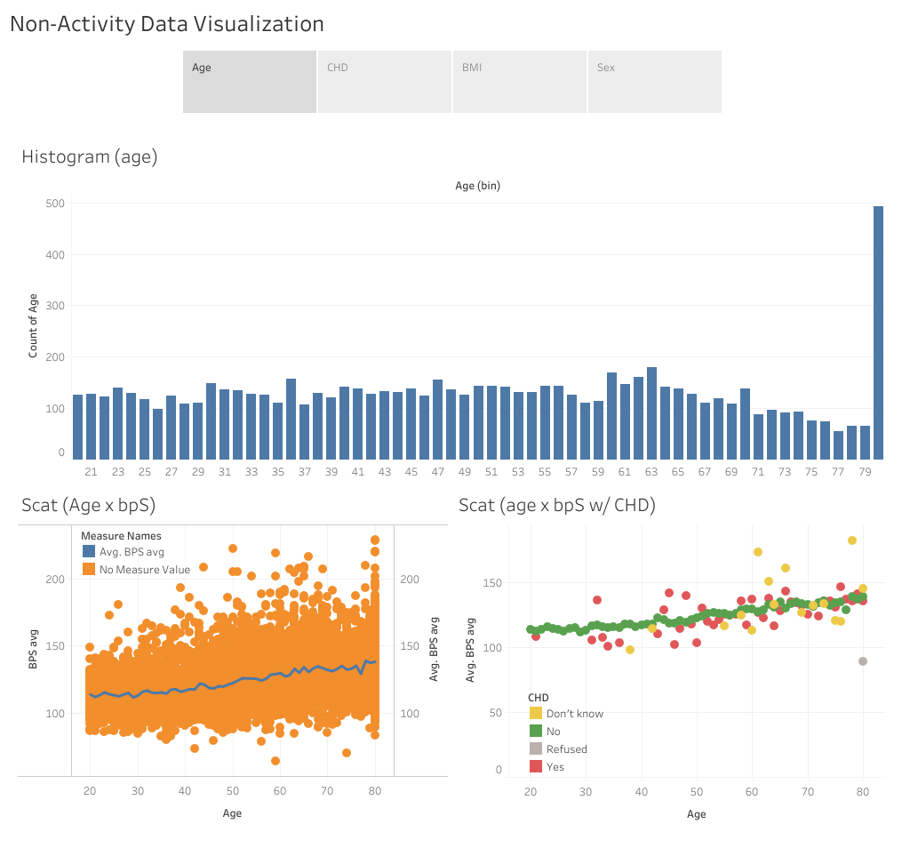

Slide 3
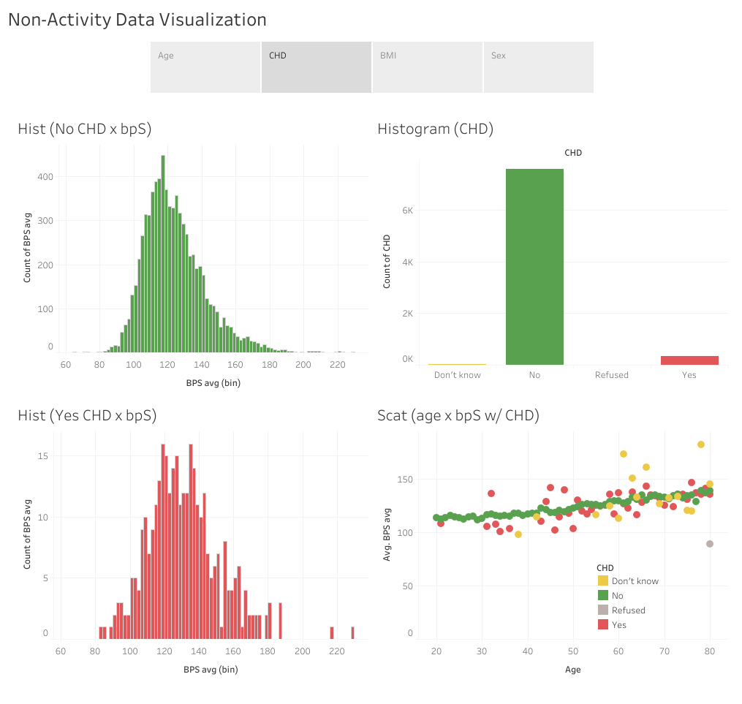

Slide 4
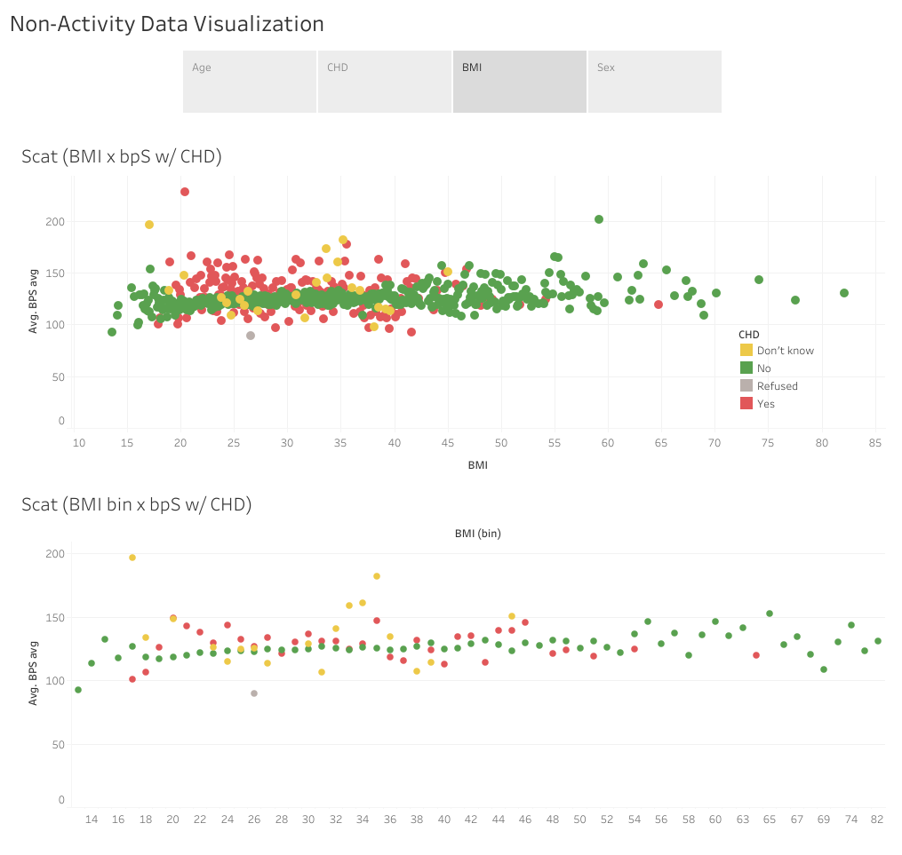

Slide 5
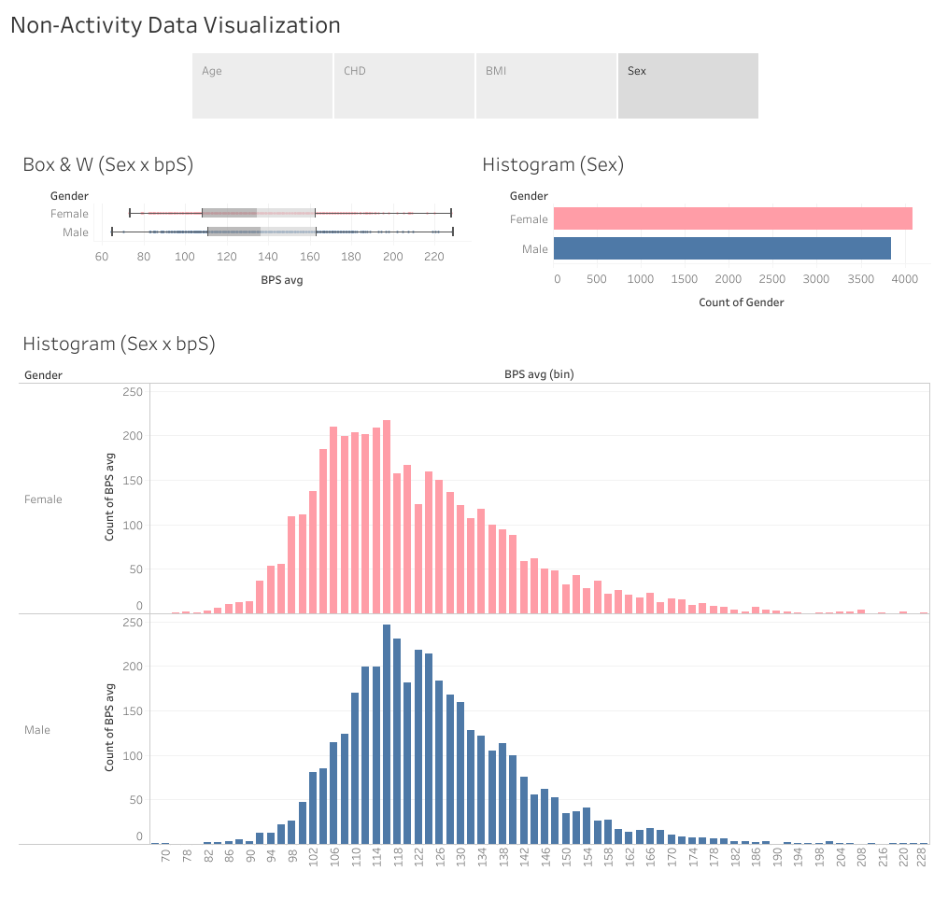

Slide 6
MIMS activity visualizations
File created on: 5/23/25 4:19:59 PM EDT

Slide 7
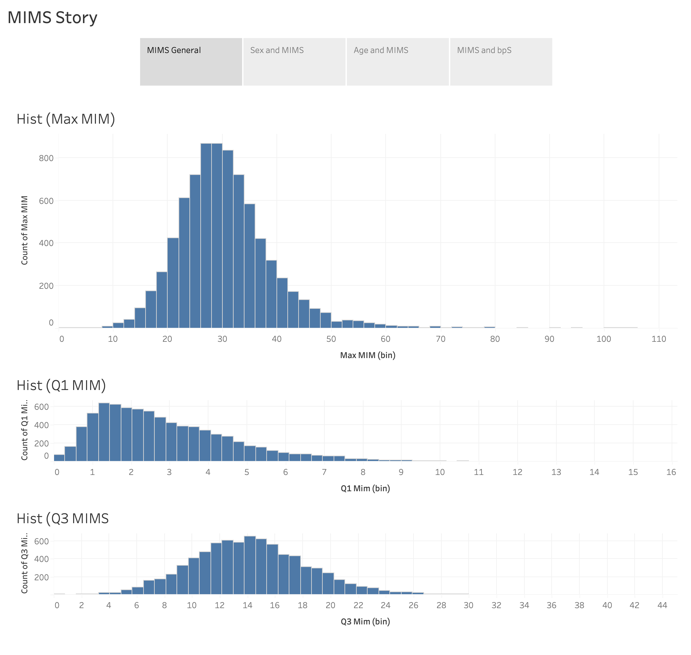

Slide 8
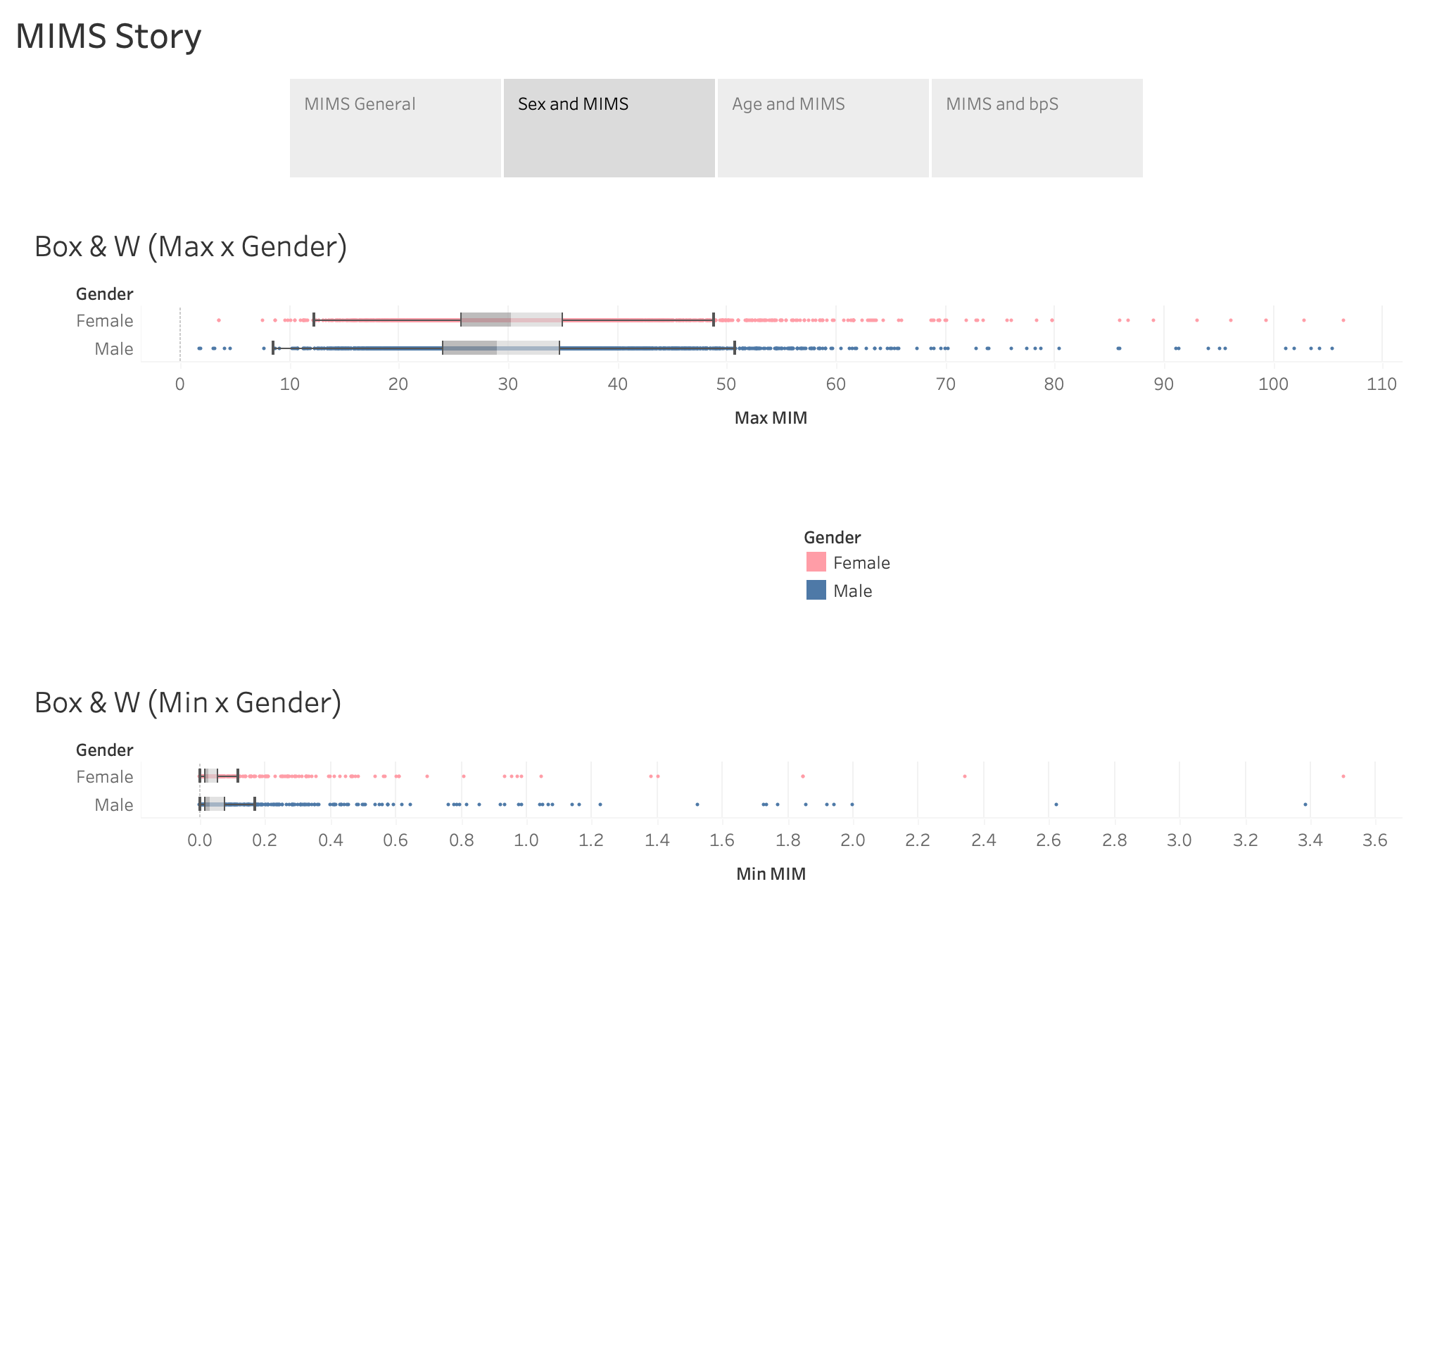

Slide 9
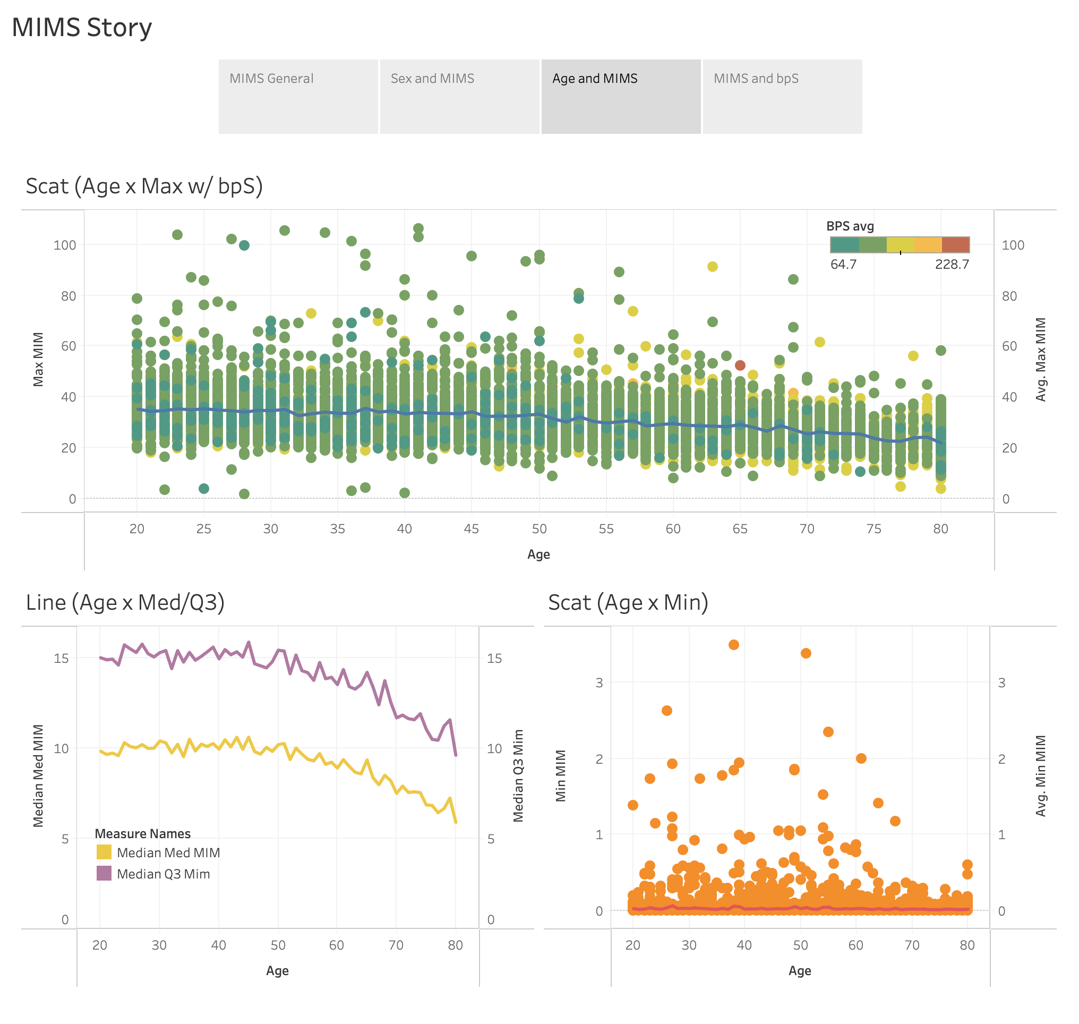

Slide 10
